Slide 1
Chapter 21 - Web Servers
(IIS and Apache)
Outline
21.1 Introduction
21.2 HTTP Request Types
21.3 System Architecture
21.4 Client-Side Scripting versus Server-Side Scripting
21.5 Accessing Web Servers
21.6 Microsoft Internet Information Services (IIS)
21.6.1 Microsoft Internet Information Services (IIS) 5.0
21.6.2 Microsoft Internet Information Services (IIS) 6.0
21.7 Apache Web Server
21.8 Requesting Documents
21.8.1 XHTML
21.8.2 ASP.NET
21.8.3 Perl
21.8.4 PHP
21.8.5 Python
21.9 Web Resources

Slide 2
Objectives
In this lesson, you will learn:
  To understand a Web server’s functionality.
  To introduce Microsoft Internet Information Services (IIS) and Apache Web server.
  To learn how to request documents from a Web server.

Slide 3
21.1 Introduction
Web server
  Responds to client requests by providing resources
URI (Uniform Resource Identifier)
Web server and client communicate with platform-independent Hypertext Transfer Protocol (HTTP)

Slide 4
21.1 Introduction

Slide 5
21.2 HTTP Request Types
Request methods
  get
  post
  Retrieve and send client form data to Web server
  Post data to a server-side form handler

Slide 6
21.3 System Architecture
Multi-tier application (n-tier application)
  Information tier (data or bottom tier)
    Maintains data for the application
    Stores data in a relational database management system (RDBMS)
  Middle tier
    Implements business logic and presentation logic
    Control interactions between application clients and application data
  Client tier (top tier)
    Application’s user interface
    Users interact directly with the application through the client tier

Slide 7
21.4 Client-Side Scripting versus Server-Side Scripting
Client-side scripts
  Validate user input
    Reduce requests needed to be passed to server
    Access browser
    Enhance Web pages with DHTML, ActiveX controls, and applets
Server-side scripts
  Executed on server
  Generate custom response for clients
  Wide range of programmatic capabilities
  Access to server-side software that extends server functionality

Slide 8
21.5 Accessing Web Servers
Request documents from Web servers
  Host names
  Local Web servers
    Access through machine name or localhost
  Remote Web servers
    Access through machine name
  Domain name or Internet Protocol (IP) address
    Domain name server (DNS)
      Computer that maintains a database of host names and their corresponding IP address

Slide 9
21.6 Microsoft Internet Information Services (IIS)
An enterprise-level Web server that is included with Windows

Slide 10
21.6.1 Microsoft Internet Information Services (IIS) 5.0
FTP Site
  Used for transferring large files across the Internet
HTTP Site
  Used most frequently to request documents from Web servers
SMTP Virtual Server
  Sends and receives electronic mail
Web Site Content Directory
  Directory containing the documents that clients will view

Slide 11
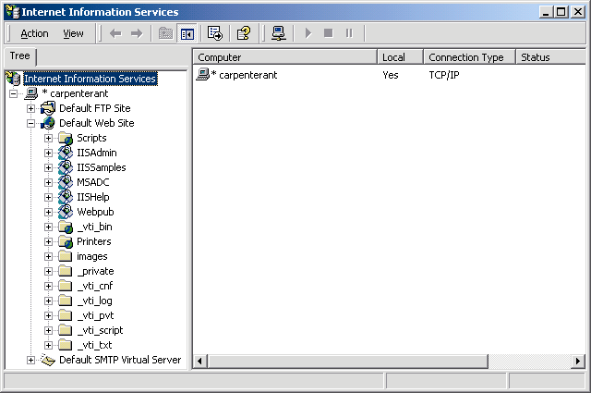
21.6.1 Microsoft Internet Information Services (IIS) 5.0
Fig. 21.3 Internet Information Services window of Internet Services Manager.

Slide 12
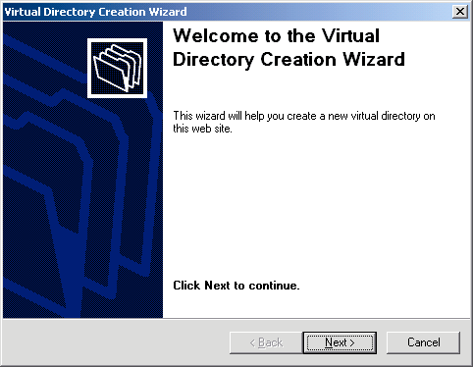
21.6.1 Microsoft Internet Information Services (IIS) 5.0
Fig. 21.4 Virtual Directory Creation Wizard welcome dialog.

Slide 13
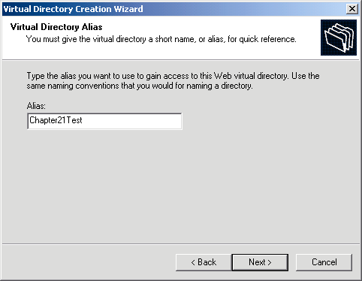
21.6.1 Microsoft Internet Information Services (IIS) 5.0
Fig. 21.5 Virtual Directory Alias dialog of the Virtual Directory Creation Wizard.

Slide 14
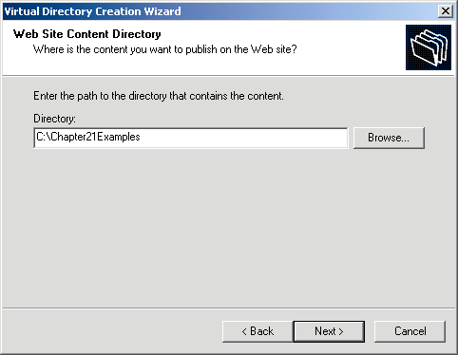
21.6.1 Microsoft Internet Information Services (IIS) 5.0
Fig. 21.6 Web Site Content Directory dialog of the Virtual Directory Creation Wizard.

Slide 15
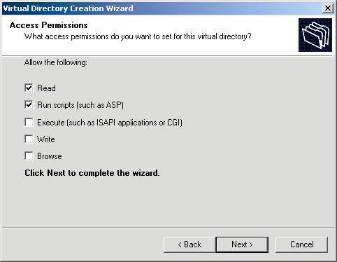
21.6.1 Microsoft Internet Information Services (IIS) 5.0
Fig. 21.7 Access Permissions dialog of the Virtual Directory Creation Wizard.

Slide 16
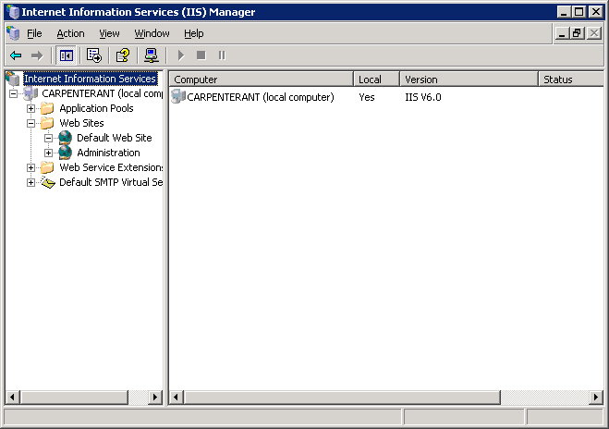
21.6.2 Microsoft Internet Information Services (IIS) 6.0
Fig. 21.8 Internet Information (IIS) Services Manager window.

Slide 17
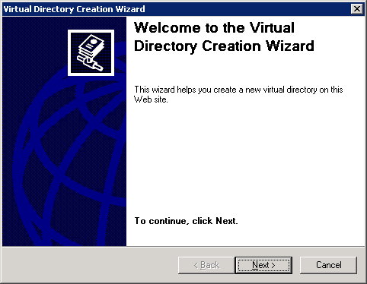
21.6.2 Microsoft Internet Information Services (IIS) 6.0
Fig. 21.9 Virtual Directory Creation Wizard welcome dialog.

Slide 18
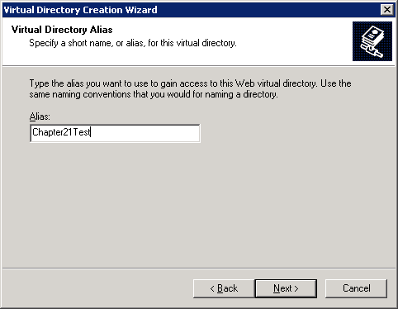
21.6.2 Microsoft Internet Information Services (IIS) 6.0
Fig. 21.10 Virtual Directory Alias dialog of the Virtual Directory Creation Wizard.

Slide 19
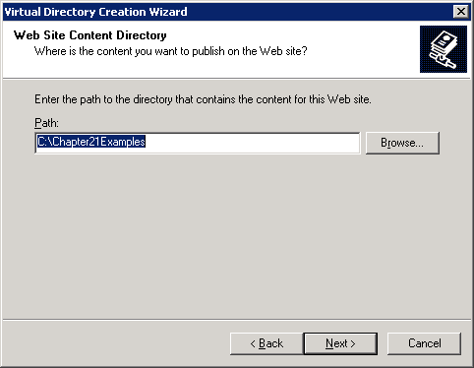
21.6.2 Microsoft Internet Information Services (IIS) 6.0
Fig. 21.11 Web Site Content Directory dialog of the Virtual Directory Creation Wizard.

Slide 20
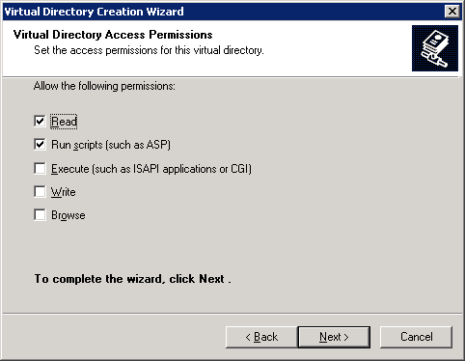
21.6.2 Microsoft Internet Information Services (IIS) 6.0
Fig. 21.12 Access Permissions dialog of the Virtual Directory Creation Wizard.

Slide 21
21.7 Apache Web Server
Currently the most popular Web server
Stability
Efficiency
Portability
Open-source

Slide 22

21.7 Apache Web Server
Fig. 21.13 Apache Web server starting. (Courtesy of The Apache Software Foundation.)

Slide 23
21.8 Requesting Documents
Requesting five different documents
  XHTML
  ASP.NET
  Perl
  PHP
  Python

Slide 24
21.8.1 XHTML
Request XHTML documents from IIS 6.0 or Apache
  Launch Internet Explorer
  Enter XHTML document’s location in Address field

Slide 25
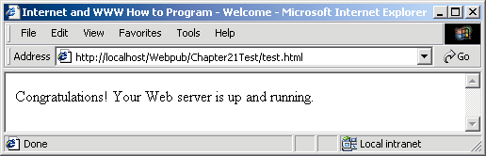
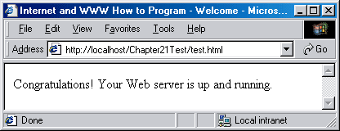
21.8.1 XHTML
Fig. 21.14 Requesting test.html from IIS 5.
Fig. 21.15 Requesting test.html from IIS 6 or Apache.

Slide 26
21.8.2 ASP.NET
Request ASP.NET document from IIS 5 or 6
  Launch Internet Explorer
  Enter ASP.NET document’s location in Address field
Apache support ASP Classic but doesn’t support ASP.NET

Slide 27
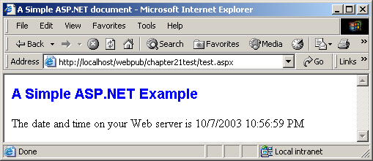
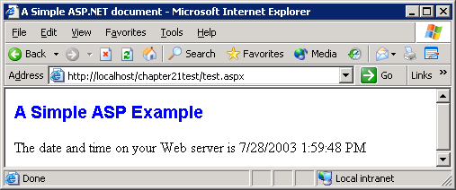
21.8.2 ASP.NET
Fig. 21.16 Requesting test.aspx from IIS 5.
Fig. 21.17 Requesting test.aspx from IIS 6.

Slide 28
21.8.3 Perl
Request Perl document from IIS 5 or 6
  Launch Internet Explorer
  Enter the Perl document’s location in the Address field
Request Perl document on Apache Web server
  Put all Perl documents in cgi-bin directory
  Launch Internet Explorer
  Enter Perl document’s location in Address field

Slide 29
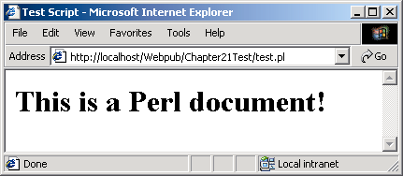
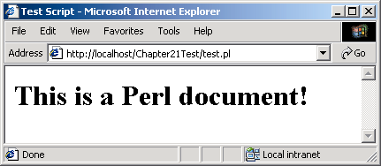
21.8.3 Perl
Fig. 21.18 Requesting test.pl from IIS 5.
Fig. 21.19 Requesting test.pl from IIS 6.

Slide 30
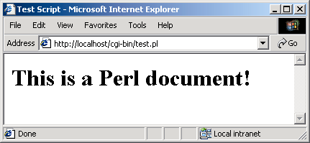
21.8.3 Perl
Fig. 21.20 Requesting test.pl from Apache.

Slide 31
21.8.4 PHP
Request PHP documents from IIS 5 and 6
  Launch Internet Explorer
  Enter PHP document’s location in the Address field
Request PHP documents from Apache
  Save PHP documents in the htdocs directory
  Launch Internet Explorer
  Enter PHP document’s location in Address field

Slide 32
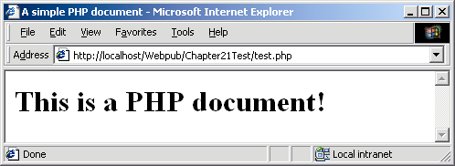

21.8.4 PHP
Fig. 21.21 Requesting test.php from IIS 5.
Fig. 21.22 Requesting test.php from IIS 6.

Slide 33
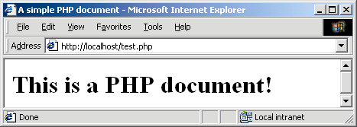
21.8.4 PHP
Fig. 21.23 Requesting test.php from Apache.

Slide 34
21.8.5 Python
Request Python documents from IIS 5 and 6
  Launch Internet Explorer
  Enter Python document’s location in the Address field
Request Python documents from Apache Web server
  Put Python documents in cgi-bin directory
  Launch Internet Explorer
  Enter Python document’s location in Address field

Slide 35
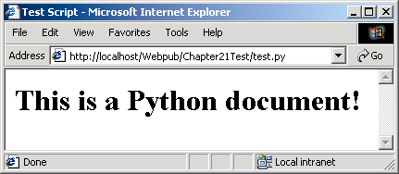

21.8.5 Python
Fig. 21.24 Requesting test.py from IIS.
Fig. 21.25 Requesting test.py from IIS 6.

Slide 36
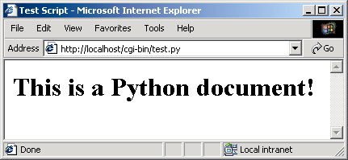
21.8.5 Python
Fig. 21.26 Requesting test.py from Apache.

Slide 37
21.9 Web Resources
www.microsoft.com/msdownload/ntoptionpack/askwiz.asp
www.w3.org/Protocols
www.apache.org
httpd.apache.org
httpd.apache.org/docs-2.0
www.apacheweek.com
linuxtoday.com/stories/18780.html
www.iisanswers.com
www.iisadministrator.com

